Slide 1
LLM Project
Noemie Lamontagne

Slide 2
ABOUT Project/ Objective
To learn more about large language models (ML models that generate text), I decided to try and create my own mostly from scratch by following along the CS336 Stanford course materials. The wanted result was a model that was trained locally on my laptop and could generate text.

Slide 3
Overview
Tokenizer
Creates the vocabulary of your model, transforming words into meaningful numbers
Dataset
Create a dataset for your model using your unique vocabulary
Model architecture
Define your model architecture
Training and Inference
Train the model, then use it to generate works based on a prompt

Slide 4
Tokenizer
BPETokenizer
Training
A tokenization method that merges the most frequent pairs of bytes (within a text) to create a fixed-size library/vocabulary where merged byte pairs are given their own token id.
My tokenizer has a 32k token vocabulary (dict[int,bytes]). 0-255 of the token ids are the “original” byte representations of alphanumeric characters; the rest of the token ids were assigned during training
You “train” a bpe tokenizer to create the vocabulary it will use to decode and encode text.
I used a pretokenization method where I read through a text and use regex to capture words as “pretokens” that are stored in a dictionary. Dict[string,freq]
The dictionary of “pretokens” is then iterated through to count the frequency of every byte pair. The most frequent byte-pair is merged and assigned a token id in the vocabulary and the iteration continues.
Our target audience is Gen Z (18-25 years old)
EASY TO USE
Simple design that gives customers the targeted information they need

Slide 5
Tokenizer OVERVIEW
Pretoken dictionary
Vocabulary
Stores words/bytes as keys, their frequency as values. The keys are a tuple of integers/token ids that represent bytes/text. The value is the # of times the pretoken appeared in the text.
Eventually we will have a vocabulary which is a dictionary where the keys are integers (token_ids) and the values are base64 encoded bytes.
Process repeats
Why?
Iterate through the keys of the pre-token dictionary to find the most frequent byte pair. This byte pair is then given a new token id according to the vocabulary. Then this byte pair is also replaced with this new id within the pretoken dictionary. E.g The -> (116, 104, 101)
This is a more logical way of training a model.
With a vocabulary made up of words, a model can predict the next word rather than the next subword or character.

Slide 6
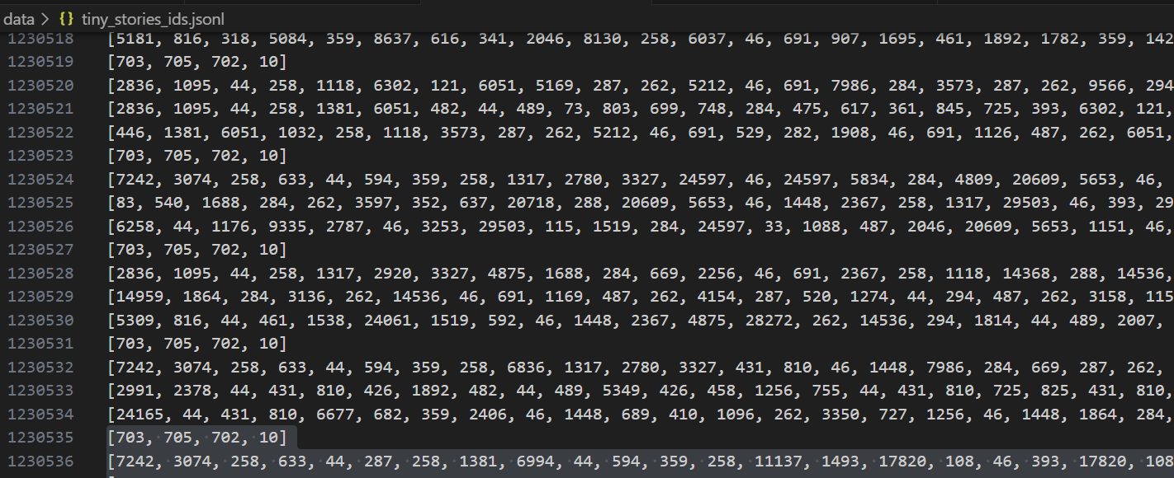
Dataset
Simple but time-consuming. Using my trained tokenizer, I encoded a text file and saved it to a JSON file.

Slide 7
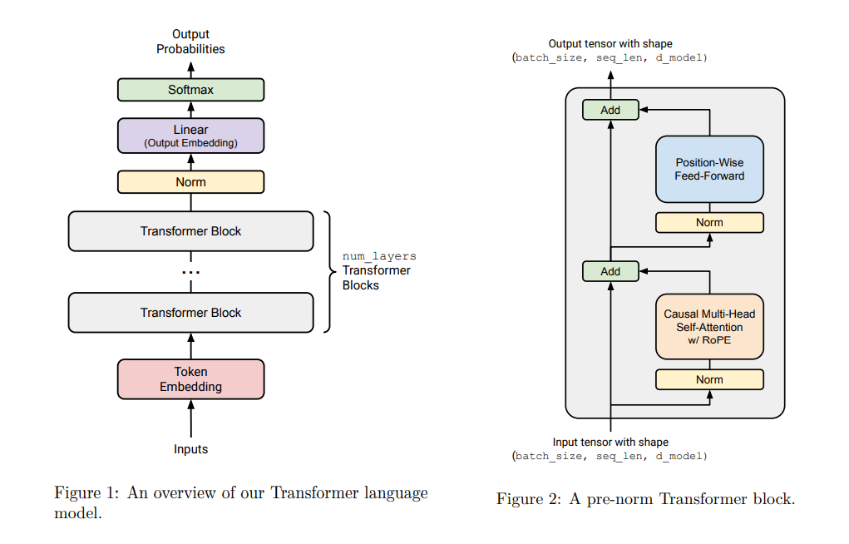
Model Architecture

Slide 8
Big Picture
Token Embedding
Transformer blocks
Output probabilities
Create meaningful vector shapes from words
Where the “learning occurs” during training
Normalize for stability (numbers can vary a lot), final linear layer (for the final logits), softmax (or other function) for meaningful probabilities, and to choose the “next word”. More relevant during inference.

Slide 9
Transformer Blocks
1. LayerNorm
2. Multi-head self-attention
3. Residual connection
4. LayerNorm
5.Feed-forward network
6.Residual connection and output
LayerNorm
Normalizes the inputs of each layer within the network. input tensor of shape (batch_size, seq_len, d_model). Keeps things stable
Multi-head self attention
Where the “learning occurs” during training. Or rather, where the model recognizes relationships between words. I do not understand the mathematics behind it.
Feed-forward network
Residual connection
Consists of multiple funcions. Mine is 2 linear layers and ReLu function. Similar purpose to the self attention, however self attention is more global (contextual meaning) and FFn is more local (individual meaning, fact). Do not fully understand this either.
Adds the attention output back to the original input .This residual connection helps preserve original information.

Slide 10
training
Witihin an Epoch for each batch
Loss and optimization
Dataloader -> to load input ids and targets
Forward pass:
-> gets the model predictions from the architecture prev. described
-> Calculates loss from the original predictions (logits) and the targets.
Backward pass:
->Zero the optimizer gradients for this new batch
-> Backpropagation: uses the chain rule of calculus (gradient) to determine how much each parameter in the neural network contributed to that loss.
->Step the optimizer: updates parameters based on the loss gradient from backpropagation.
Forward vs. backward
I use cross-entropy and AdamW. That was what was recommended to me. I used a scheduler as well.
Optimizer: adjusts a model's parameters (like weights and biases) to minimize its loss function.
Loss: how close/far the model was to the target
In the forward pass, our model attempts a prediction,
In the backward pass, we learn from our attempt.
Will repeat this process for each batch of data, with multiple batches per epoch.

Slide 11
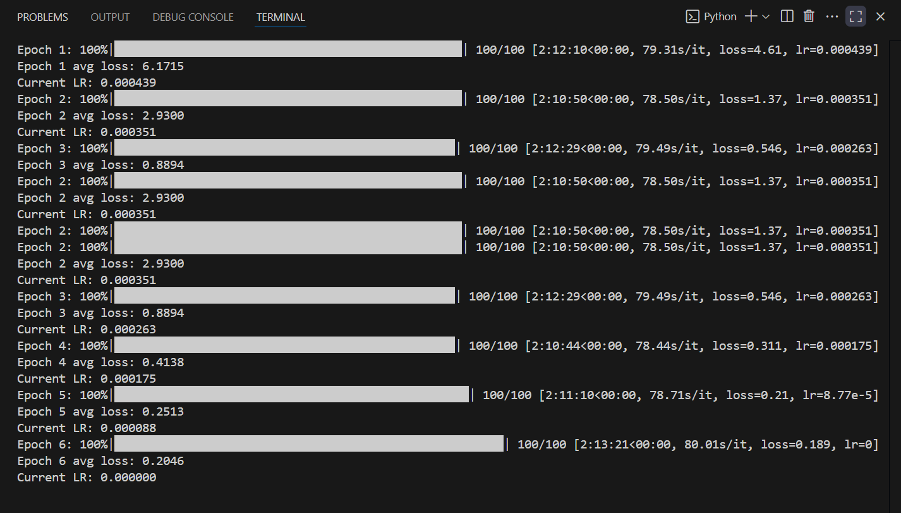
Training Log

Slide 12
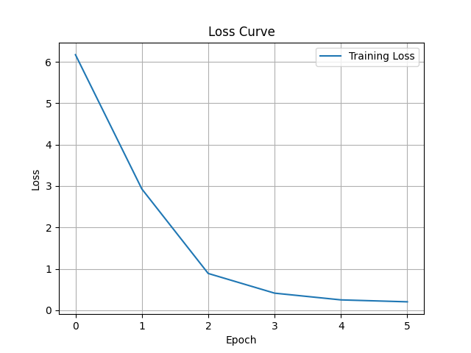
Loss curve

Slide 13
Inference
Similar to training, except instead of learning from our predictions and updating weights, we simply choose the best prediction.
Do a forward pass, extract the logits (predictions) for the last token.
Softmax function to convert logits into a probability distribution
Multinomial to choose one.
NB: logits.shape -> (batch_size, sequence_length, vocab_size).
Therefore each token id (in the sequence length) has an associated vector (vocab_size) where each token_id will have a probability of being the “next token”.
COMPETITORS
Simi
Company A Product is more expensive
Companies B & C Product is expensive and inconvenient to use
Companies D & E Product is affordable, but inconvenient to use

Slide 14
Result
The result was a model that could generate text, however, it is nonsensical and does not follow proper grammar or sentence structure. I either need to improve the model or the generate function. This was also only assignment 1, there is more tuning to be done to this model and generation functions.
Was not as successful as my last project, but the demo and code for that are on my GitHub.
Now I’d like to go over the code, and a short demo of some of the functions, if time permits.

